Slide 1

People Clues
BI tool to dynamically select the best team for a given project

Slide 2

Team Dynamics

Slide 3
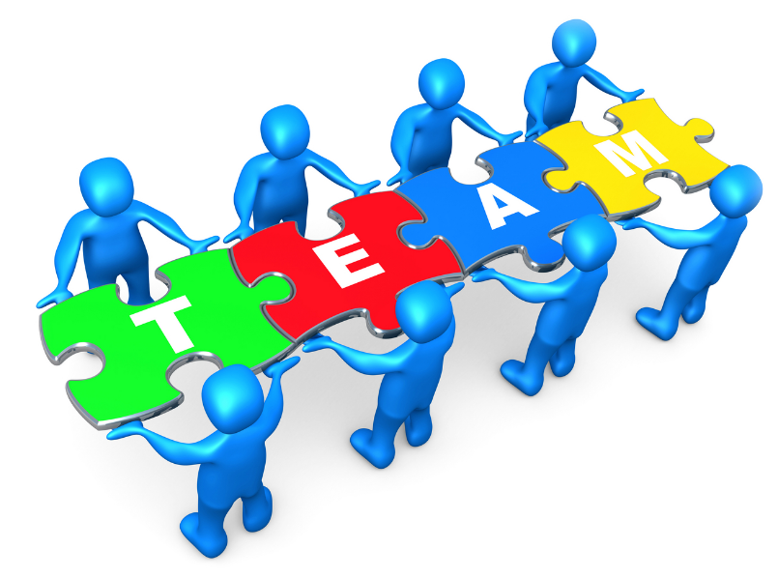
What is Team Dynamics?
How people work and interact together in teams
Team dynamics are the hidden strengths and weaknesses that operate in a team between different people or groups and how they affect the way a team reacts, behaves or performs

Slide 4
We are developing a BI tool for Human Resources to accurately select teams for a given project
by analyzing qualifications, experiences and past performance

Slide 5
Problems with existing methods
Teams are selected by the experience of the senior management
After retirement knowledge transferring process is very difficult by the humans
Selections are sometimes biased
The right person for the right group will not be selected; as a result of this, employees and employers can be frustrated

Slide 6
Therefore there is need for a BI tool to select the right person for the right job for a project in order to finish the project satisfying:
Scope of the project
Finishing the project within the given period
Meeting the budget and required quality

Slide 7



Business Intelligence
Analytics
Predictive Modeling
Data Mining

Slide 8






Problems with existing BI Tools
High cost
ETL tools and Predictive Analytics tools are sold as separate products
Expert knowledge is needed
More generalized Doesn’t fit into local systems

Slide 9





Products Available in the Market
$125,600
$ 177,000
$ 225,000
$235,000
$365,000

Slide 10
People Clues
BI tool to dynamically select the best team for a given project
High reliability and low cost solution

Slide 11


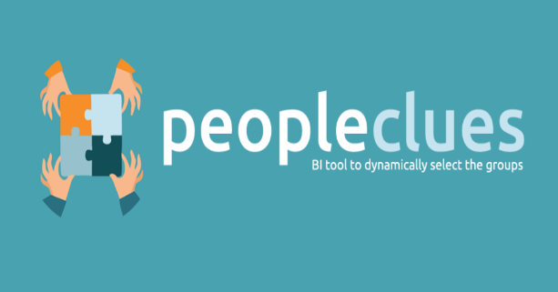

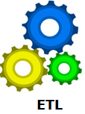

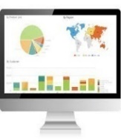
Features of People Clues
Result-oriented Suggestions
Interactive Dashboard
Graphical Reports
ETL Tool
Efficient Prediction
Visual Analytics

Slide 12
Comparison
Features | POP™ | A Team Formation Tool | CATME Team Maker | Oracle BI | Birst | MS Share Point | IBM Cognos | People Clues
ETL Tool (Automated) |  |  |  |  |  |  |  | ✓
Optimal solution | ✓ |  |  |  |  |  |  | ✓
Feasible Solution |  |  |  |  |  |  |  | ✓
Consider about role of each team member | ✓ |  |  |  |  |  |  | ✓
Applicable for many roles |  | ✓ | ✓ | ✓ | ✓ | ✓ | ✓ | ✓
All the users do not need to interact with the system | ✓ |  |  | ✓ | ✓ | ✓ | ✓ | ✓
Visualization of data in an abstract way |  |  |  |  | ✓ | ✓ |  | ✓
Predictive Analytics | ✓ |  | ✓ | ✓ | ✓ | ✓ | ✓ | ✓

Slide 13
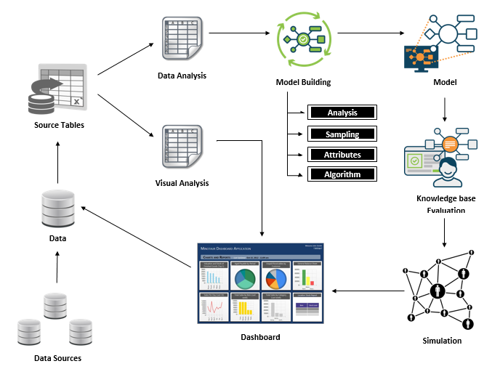
System Architecture

Slide 14

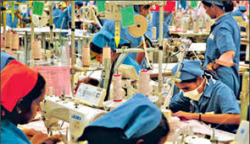
Targeted Industries
Information Technology
Apparel

Slide 15
Reasons for selecting the targeted Industries
IT industry and apparel always work with teams
Both are high scaled and major industries
Time and money are vital constraints
Success of the projects completely depends on the people involved with the projects
Plays a big role in the Finance Sector
Rise in using information systems is high in the selected industries
Large scaled data to be processed is available

Slide 16

IT – Best Team Formation
Team Formation :
Select the members for the roles in order to create a complete team for a given project
Team Prediction:
Predict the best members for the roles in order to achieve the highest success rate

Slide 17
Apparel – Best Team Formation
Team Formation :
Select the members for the roles in order to create a complete team for a given task
Team Prediction:
Predict the best members for the roles in order to achieve the highest success rate

Slide 18
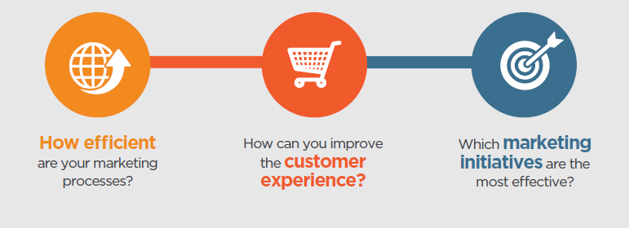
Advantages of using BI
Source: http://whitepapers.business2community.com/1539/

Slide 19
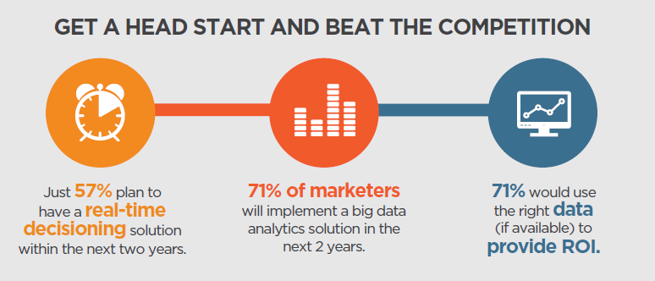
Is Business Intelligence worth the investment?
Source: http://whitepapers.business2community.com

Slide 20
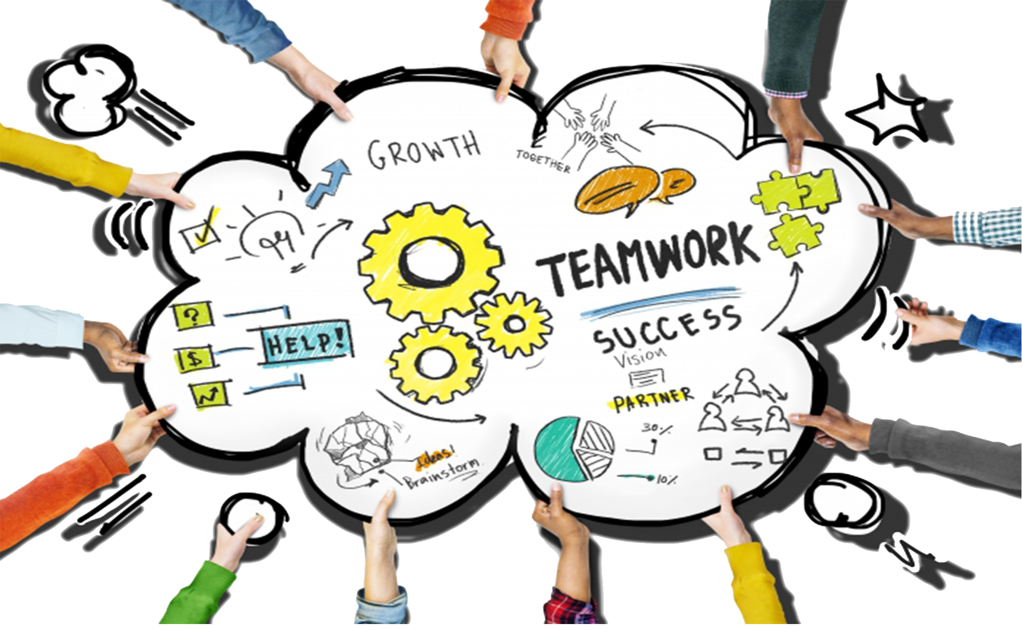
Advantages of Team Dynamics

Slide 21
Methodology
BI Tool
Hadoop ETL
Traditional ETL
Predictive Modeling
Component 1
Component 2
Optimal
Feasible
Component 3
Component 4

Slide 22












Tools and Technologies
ETL | Predictive Modelling | Dashboard Component

Slide 23
Demo

Slide 24
Thank You
Q&A Session

